Slide 1


Department of Artificial Intelligence and Data Learning
Medibot– A Localized AI Medical Chatbot.
Done By
Arul Kumaran P
(221801004)
Harish Raghavendra R
(221801015)
Karthik A
(221801023)

Slide 2
Problem Statement and Motivation
Lack of instant and reliable access to medical information.
Healthcare professionals need quick access to medical references.
Difficulty in retrieving specific medical knowledge from large document repositories.
Bridge the gap between users and accurate medical knowledge.
Provide a conversational AI that delivers trusted medical insights.
Support medical education and research with a knowledge-driven AI assistant.

Slide 3
Objectives
Develop an AI-powered chatbot for medical query resolution.
Implement a retrieval-based QA system using FAISS and LangChain.
Enable efficient medical document processing through text chunking and embedding techniques.
Provide a user-friendly interface using Chainlit for seamless interaction.
Enhance scalability and adaptability for future improvements, such as multilingual support and voice integration.

Slide 4
Abstract
Healthcare and medical information accessibility are critical challenges in today’s fast-paced world. Patients often struggle to find reliable health-related information, while medical professionals require quick access to accurate references. This project presents MediBot, an AI-driven chatbot that leverages retrieval-based question answering (QA) to provide precise and contextually relevant medical insights.
MediBot processes medical documents using LangChain, embedding text data with Hugging Face Transformers, and storing it in a FAISS vector database for efficient retrieval. A fine-tuned LLaMA 2 model is used to generate responses based on retrieved content, ensuring high-quality answers. The chatbot is built with Chainlit, providing a seamless interactive experience. Future improvements include multilingual support, voice integration, and dynamic database updates to further refine its usability and accuracy.

Slide 5
Literature Survey
S. No | Author Name | Paper Title | Description | Journal | Volume/ Year
1 | Vaswani et al. | Attention Is All You Need | Introduces the Transformer model, the foundation of modern NLP architectures. | NeurIPS | 2017
2 | Devlin et al. | BERT: Pre-training of Deep Bidirectional Transformers for Language Understanding | Proposes BERT, a deep learning model for contextual NLP tasks. | NAACL-HLT | 2018
3 | Lewis et al. | Retrieval-Augmented Generation for Knowledge-Intensive NLP Tasks | Combines retrieval and generative models for improved answer generation. | NeurIPS | 2020

Slide 6
Existing System
Traditional search engines (Google, Bing) provide generic and sometimes misleading medical information.
Manual retrieval from medical textbooks and research papers is time-consuming.
Some AI-based medical assistants use general-purpose models that lack domain-specific accuracy.
Medical chatbots exist but are limited to predefined rule-based responses.

Slide 7
Drawback of Existing System
Lack of accuracy
Limited knowledge base
No efficient document retrieval
Time-consuming
Absence of personalized responses

Slide 8
Proposed System
AI-Powered Medical Chatbot – Uses NLP and Retrieval-based QA to provide accurate and relevant medical information.
AI-Powered Medical Chatbot -
Uses NLP and Retrieval-based QA to provide accurate and relevant medical information.
FAISS Vector Database -
Enables fast and precise retrieval of medical knowledge from stored documents.
Transformer-Based Model (LLaMA 2) –
Enhances response quality using a fine-tuned large language model.
Custom Prompt Engineering –
Ensures responses are relevant, factual, and context-aware.

Slide 9
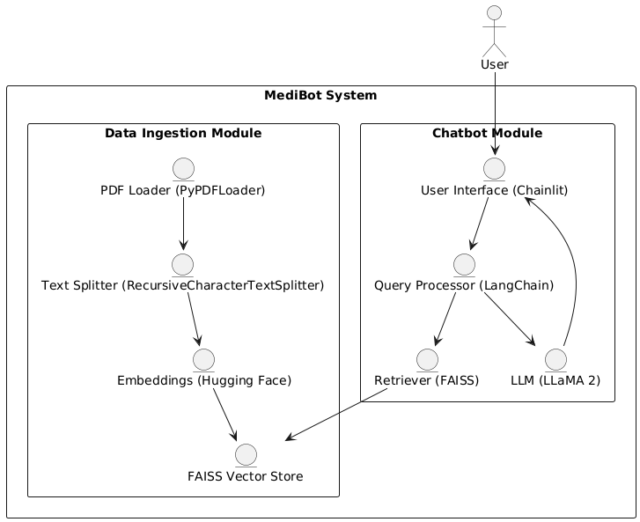
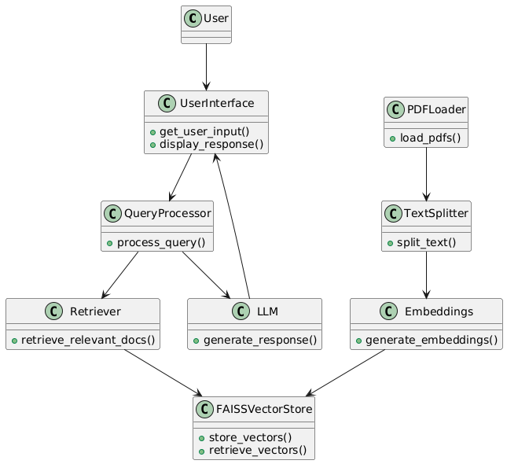
System Architecture

Slide 10
Methodology
User Interaction via Chainlit UI:
The user begins interaction through a simple, intuitive chat-based interface built using Chainlit. The interface accepts medical queries in natural language (e.g., symptoms, drug questions, treatment suggestions).
Query Processing:
Once the query is submitted, it is passed to the Query Processor. The processor checks for previously answered questions and manages communication between user input and the AI backend.

Slide 11
Methodology
Embedding and Vector Search:
The system uses SentenceTransformers to convert the query into high-dimensional embeddings. These embeddings are compared with pre-stored vectors using a FAISS Vector Database to retrieve the most relevant medical document chunks.
Knowledge Base and Document Parsing:
Documents such as PDFs, DOCX, and TXT files from trusted medical sources are stored under the /kb./ directory. These files are parsed using format-specific parsers and converted into vector embeddings to be stored in the FAISS DB.

Slide 12
Methodology
Response Generation with LLaMA3:
The model generates an accurate and relevant response using the context from the FAISS DB and query. The output is processed by the Answer Generator and sent back to the UI.

Slide 13
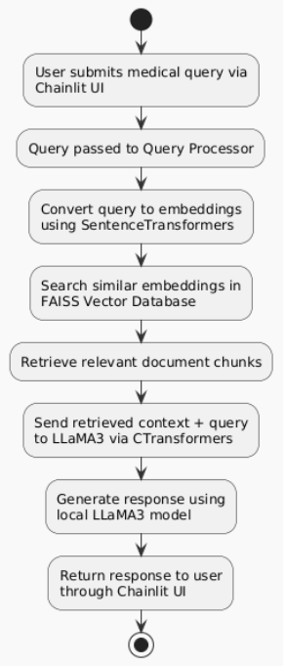
FLOWCHART

Slide 14
List of Modules
User Interface Module.
Application Backend Module.
Embedding System Module.
Model Engine Module.
Database Module.
Knowledge Base Module.
Response Module.

Slide 15
User Interface Module
Built using Chainlit framework.
Allows users to chat and send medical queries.
Displays the AI-generated responses.
Ensures smooth, intuitive interaction.

Slide 16
Application Backend Module
Controls the flow between UI, embedding, DB, and model.
Manages query processing and response logic.
Acts as the system coordinator for all modules.

Slide 17
Embedding System Module
Uses SentenceTransformers to generate embeddings.
Converts queries and documents to vector format.
Includes document parser for PDF, DOCX, and TXT files.
Splits and processes content into smaller chunks.

Slide 18
Model Engine Module
Powered by LLaMA2/LLaMA3 via CTransformers.
Takes user query + relevant context.
Generates natural, accurate responses.
Works locally to ensure privacy and fast access.

Slide 19
Database Module
Utilizes FAISS for vector storage and search.
Stores document embeddings for semantic retrieval.
Linked with index.faiss and docs.json metadata.
Returns top matching results for each query.

Slide 20
Knowledge Base Module
Contains medical documents in /kb/ directory.
Supports PDF, DOCX, and TXT formats.
Parsed and embedded for semantic search.
Automatically updated when new files are added.

Slide 21
Response Module
Formats the output from the language model.
Ensures clarity, grammar, and relevance.
Sends final response back to the Chainlit UI.
Improves user satisfaction and trust.

Slide 22
ALGORITHM
Step 1: Accept the user query through the Chainlit UI. Step 2: Preprocess the query (cleaning and formatting). Step 3: Generate embedding using SentenceTransformer. Step 4: Search the FAISS vector database using the embedding. Step 5: Retrieve top N most similar document chunks. Step 6: Combine query and retrieved context into a prompt. Step 7: Pass the prompt to LLaMA2 model via CTransformers. Step 8: Receive response from the LLM. Step 9: Format and return the response to the UI.

Slide 23
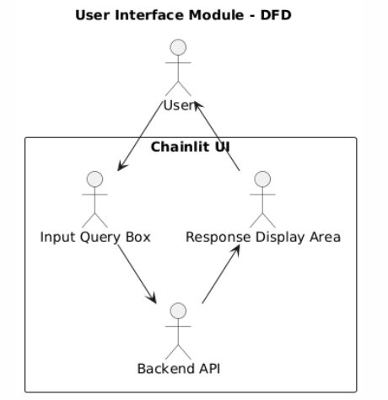
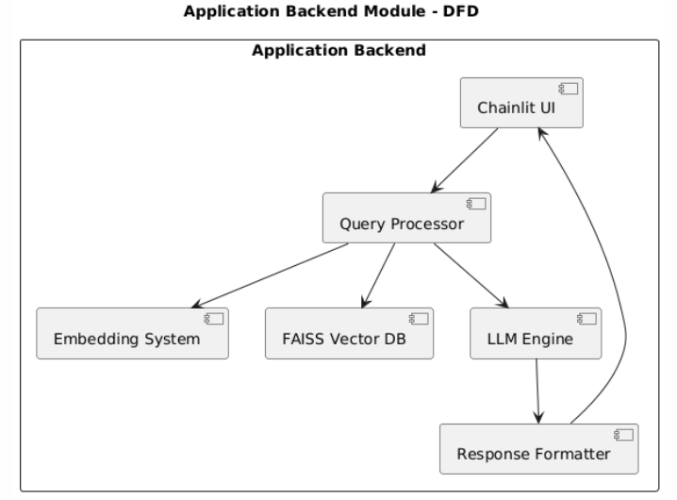
DATA FLOW DIAGRAMS

Slide 24
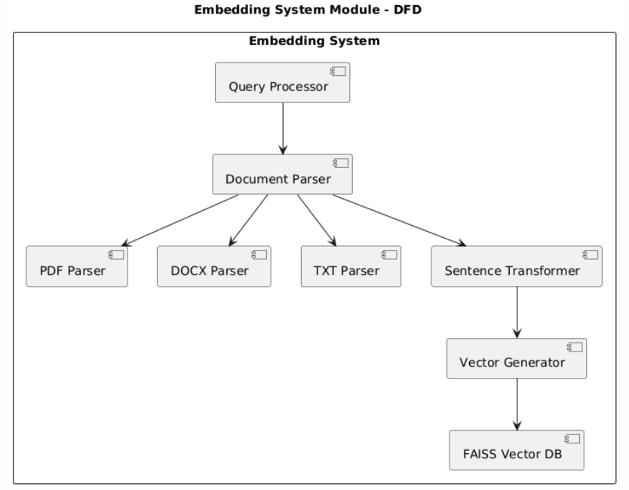
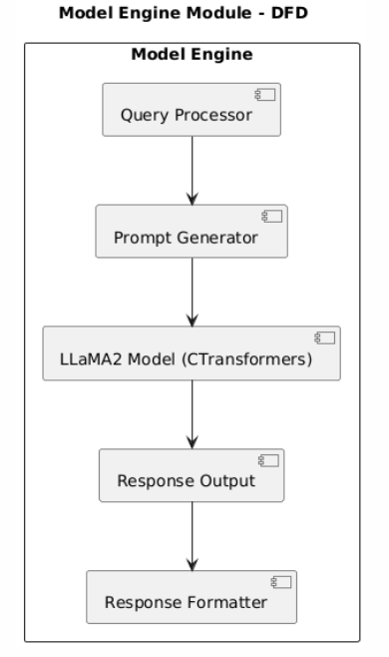
DATA FLOW DIAGRAMS

Slide 25
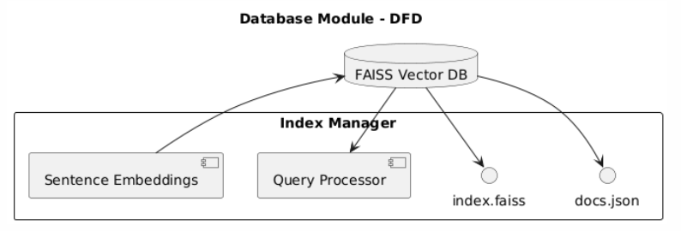
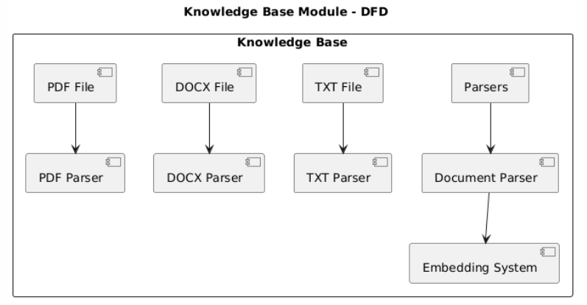
DATA FLOW DIAGRAMS

Slide 26
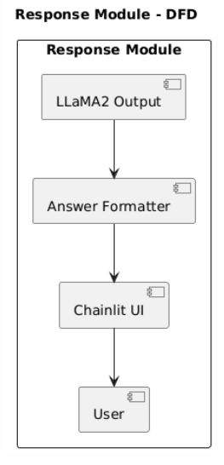
DATA FLOW DIAGRAMS

Slide 27
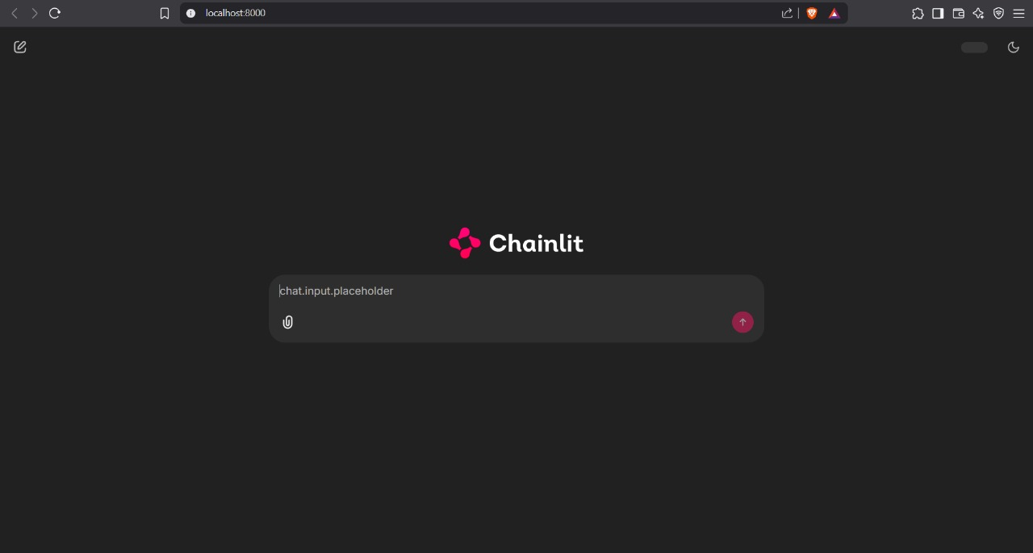
OUTPUT SAMPLES

Slide 28
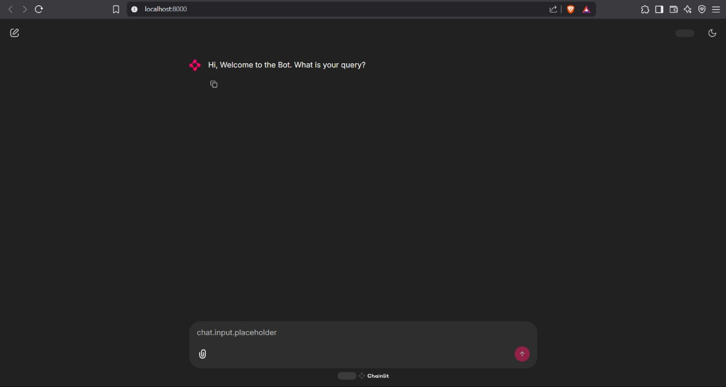
OUTPUT SAMPLES

Slide 29
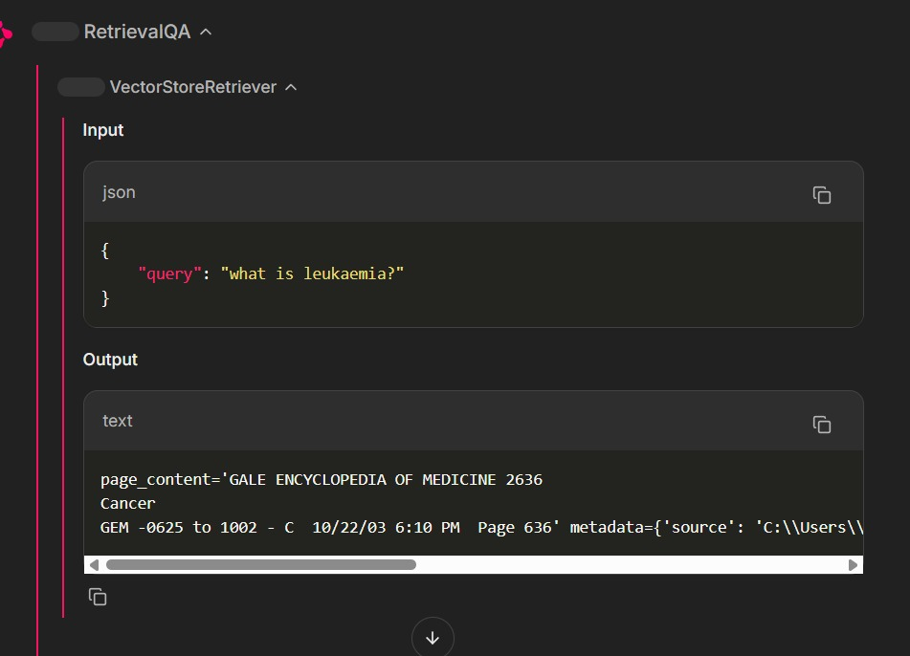
OUTPUT SAMPLES

Slide 30
OUTPUT SAMPLES

Slide 31
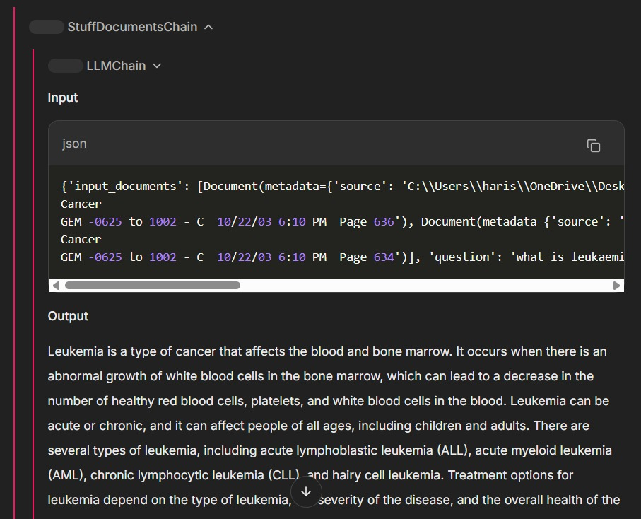
OUTPUT SAMPLES

Slide 32
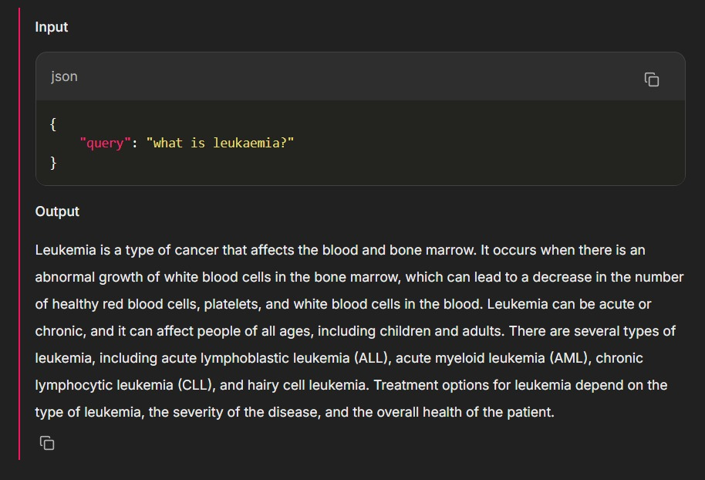
OUTPUT SAMPLES

Slide 33
Thank You

